Slide 1


Bankruptcy
Prediction

Slide 2
Business Problem:
Our project is dedicated to building a concise and effective classification model for predicting business bankruptcy. By assessing crucial features like Industrial Risk, Management Risk, Financial Flexibility, Credibility, Competitiveness, and Operating Risk, we aim to provide businesses with a proactive tool for early risk detection.
The ultimate objective is to empower organizations to make informed decisions and take timely actions, thereby enhancing their ability to navigate and mitigate the risk of bankruptcy with agility and foresight.

Slide 3
DataSet :
This is a project where the variable to be predicted is class. The data file contains 250 observations with 7 variable.
 | Industrial_risk | Management _risk | financial_ flexibility | credibility | competitiveness | Operating _risk | class
0 | 0.5 | 1 | 0 | 0 | 0 | 0.5 | bankruptcy
1 | 0 | 1 | 0 | 0 | 0 | 1 | bankruptcy
2 | 1 | 0 | 0 | 0 | 0 | 1 | bankruptcy
3 | 0.5 | 0 | 0 | 0.5 | 0 | 1 | bankruptcy
4 | 1 | 1 | 0 | 0 | 0 | 1 | bankruptcy
... | ... | ... | ... | ... | ... | ... | ...
245 | 0 | 1 | 1 | 1 | 1 | 1 | non-bankruptcy
246 | 1 | 1 | 0.5 | 1 | 1 | 0 | non-bankruptcy
247 | 0 | 1 | 1 | 0.5 | 0.5 | 0 | non-bankruptcy
248 | 1 | 0 | 0.5 | 1 | 0.5 | 0 | non-bankruptcy
249 | 1 | 0 | 0.5 | 0.5 | 1 | 1 | non-bankruptcy
250 rows × 7 columns

Slide 4
Project Architecture / Project Flow
Project Flow can be defined by the following steps
Data Cleaning
Importing the Packages
Reading the Dataset
Checking the Duplicates
Exploratory Data Analysis
Visualization
Feature Engineering
Feature Selection
Model Validation – [Train-Test-Split and Kfold]
Model Building
Final Model
Deployment

Slide 5

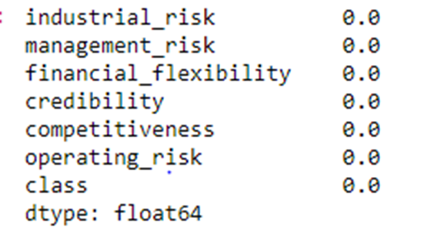
Exploratory Data Analysis (EDA)
#Checking the shape of the Dataset
#checking missing values
>>(data.isna().sum())/len(data)*100

Slide 6
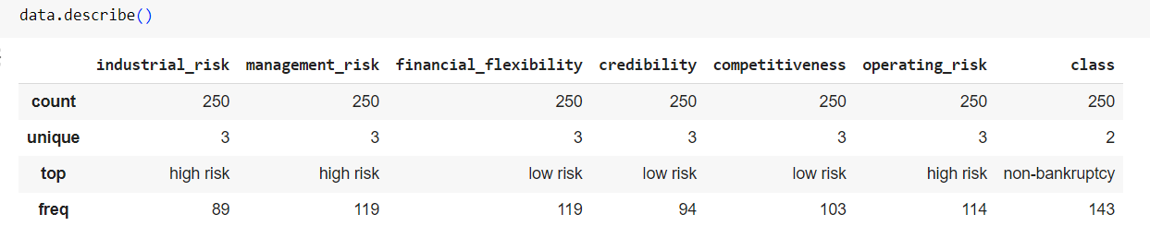
Exploratory Data Analysis (EDA)
#checking describe

Slide 7
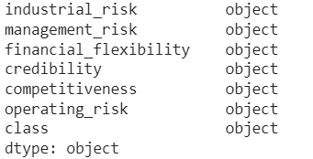
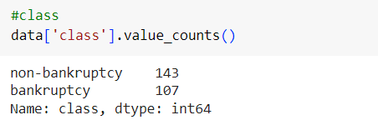
#checking dtypes
#checking class features

Slide 8
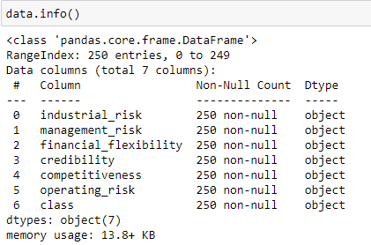

Slide 9
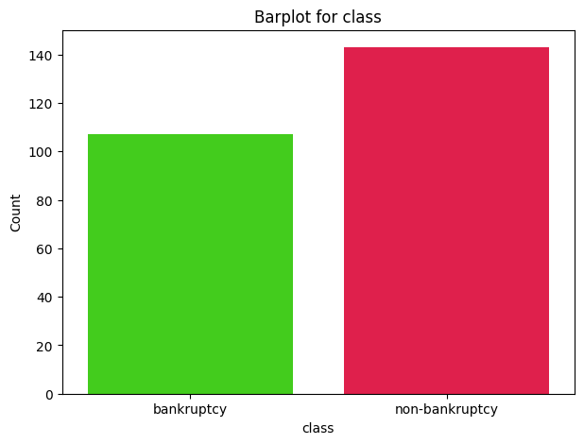
Data Visualization
CountPlot for class feature

Slide 10
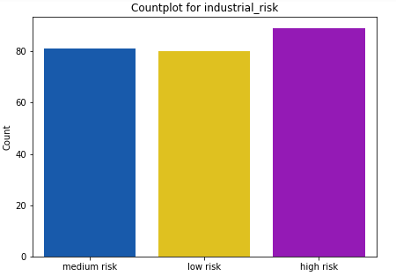
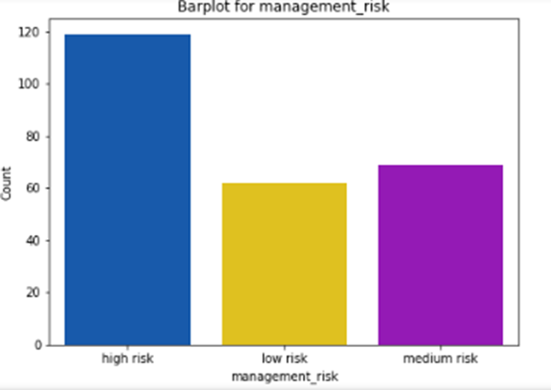
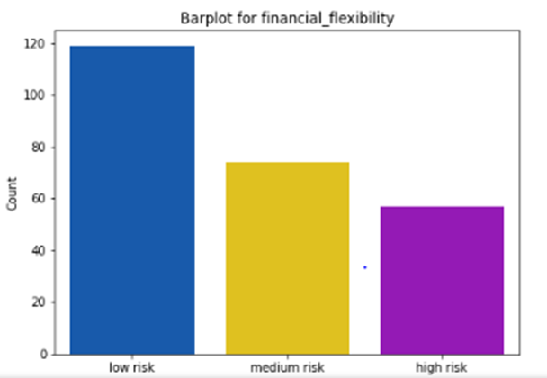
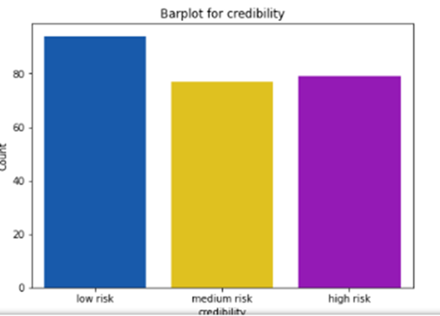
Data Visualization
Count Plots

Slide 11
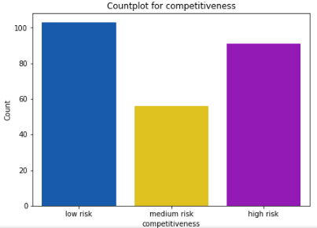
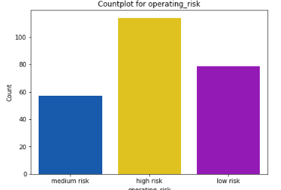
After ploting countplot we can observe that industrial_risk , management_risk, and operating_risk having more highrisk and in remaining features count of highrisk is low.

Slide 12
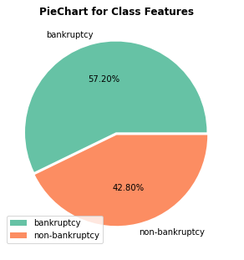
Pie Chart
In this PiePlot it showing bankruptcy and non-bankruptcy class features .Inference is, bankruptcy occurrences are more common(57.20%) than non-bankruptcy(42.80%).

Slide 13
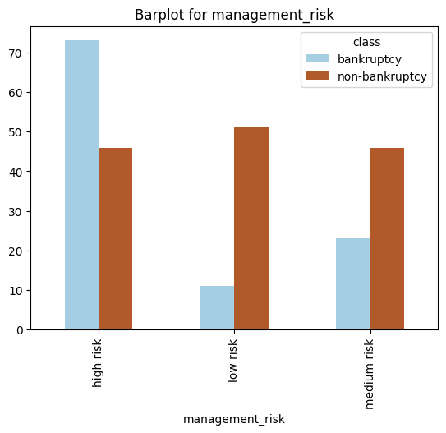
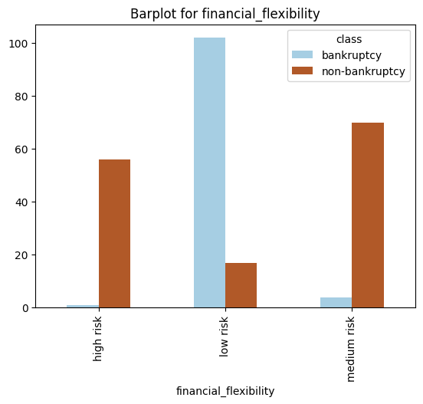
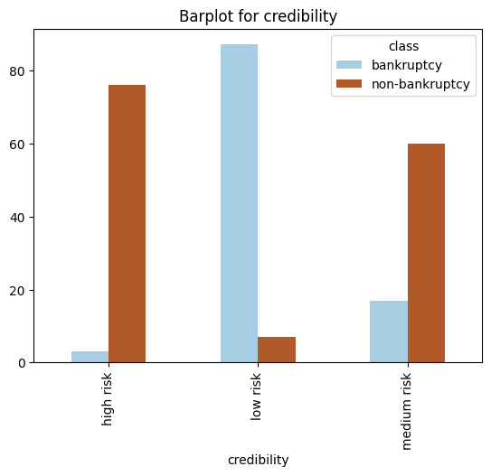
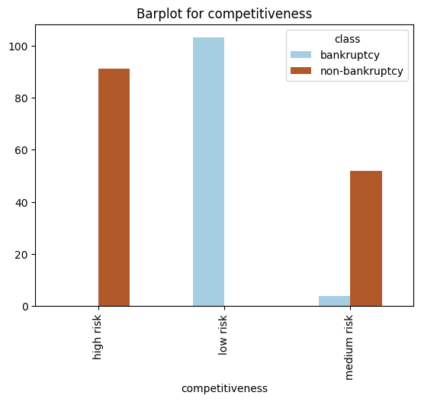
BarPlot

Slide 14
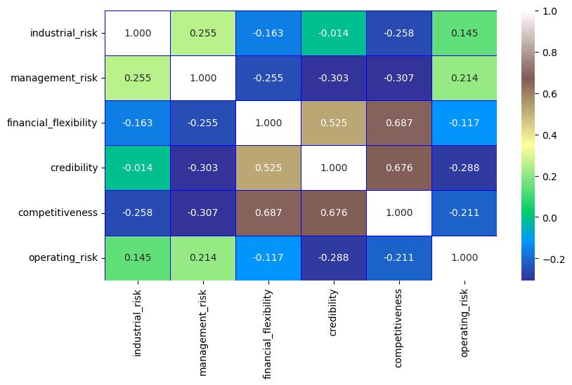
Heat Map

Slide 15
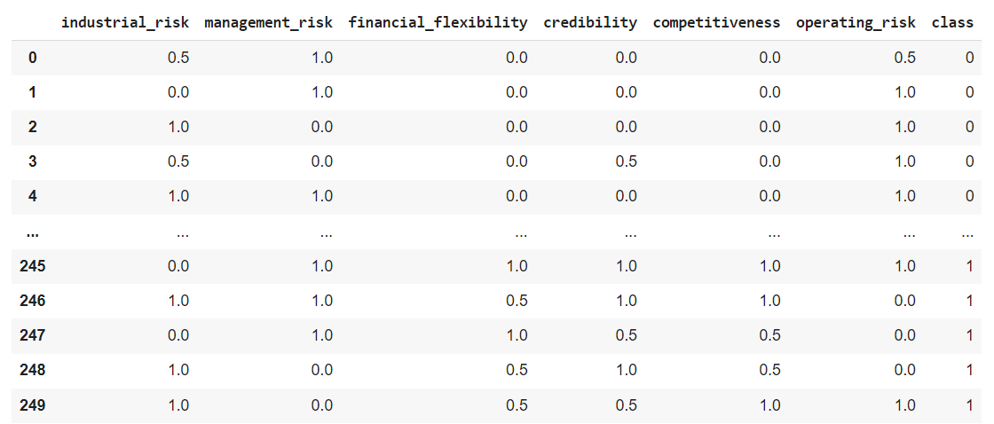
Feature Engineering
Label Encoding
#After encoding, here
#bankruptcy=0 ; non-bankruptcy=1

Slide 16
Feature Selection
Selecting Important Features using SelectKBest and Recursive Feature Eliminator
Features | Scores
industrial_risk | 4.225298
management_risk | 9.407190
financial_flexibility | 60.237242
credibility | 52.307251
competitiveness | 82.186252
operating_risk | 6.458129

Slide 17
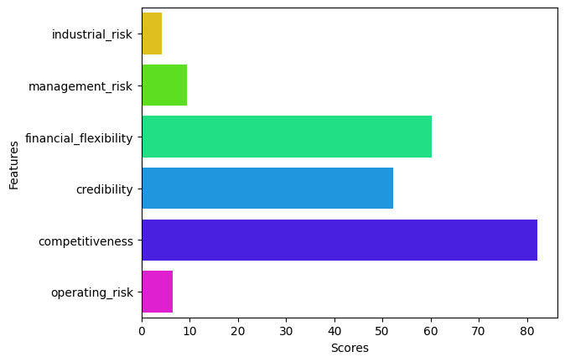
Plot shows range of Important features

Slide 18
Model Building
List of Models Using for Model Building
Logistic Regression
DecisionTreeClassifier
KNeighborsClassifier
SupportVectorClassifier
NaiveBayes
RandomForest

Slide 19
Scores of each models
SNO | Models | Scores(Testing Accuracy) | Scores(Training Accuracy) | Scores(cross_ val)
0 | Logistic Regression | 98.670 | 99.40 | 99.2
1 | Decision Tree | 98.670 | 100.00 | 99.2
2 | KNN | 98.670 | 99.40 | 99.2
3 | SVC | 98.670 | 100.00 | 99.6
4 | Naive Bayes | 98.700 | 97.71 | 98.0
5 | Random Forest | 98.667 | 100.00 | 99.2

Slide 20
Final Model
As all the model are getting approximately same accuracy score after train-test-split and cross-validation.
So let us consider “RandomForestClassifier” for our final model building
Final Accuracy:99.2%
Testing Accuracy:98.67%
Training Accuracy:100.0%
Standard Deviation: 0.024

Slide 21
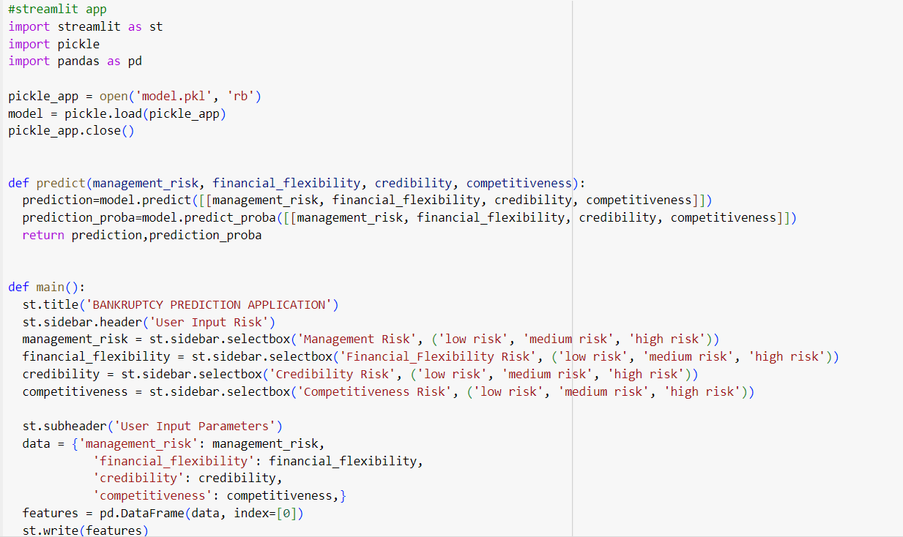
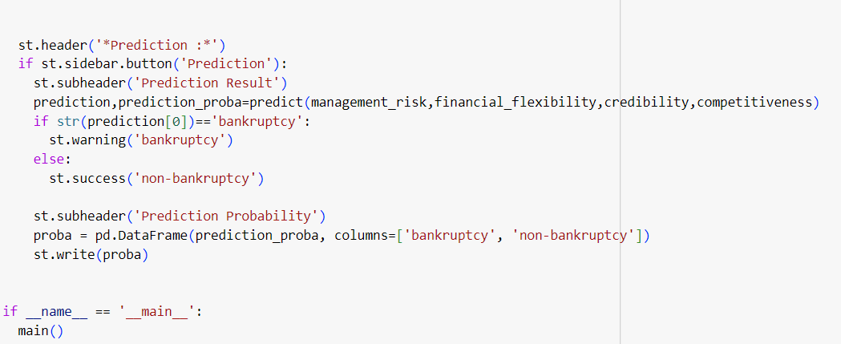
Streamlit App

Slide 22
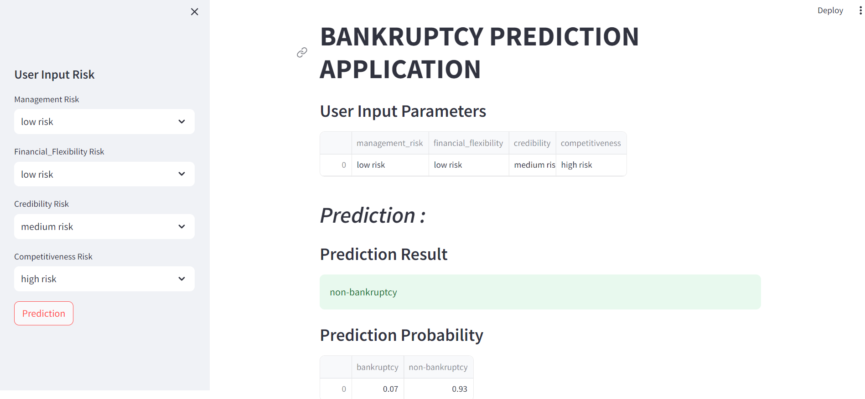
Final Web Page

